Slide 1

SMART INDIA HACKATHON 2026
TITLE PAGE
Problem Statement : SIH26113 Human augmentation technologies are transforming healthcare, rehabilitation, industrial ergonomics, assistive living, sports, and personal mobility by improving human capabilities and enhancing quality of life.
Problem Statement Title : Human augmentation enhances human abilities and quality of life
Theme : MedTech / BioTech / HealthTech
PS Category : Hardware
Team ID : TEAM – 147
Team Name : BERSERK TECHIES

Slide 2
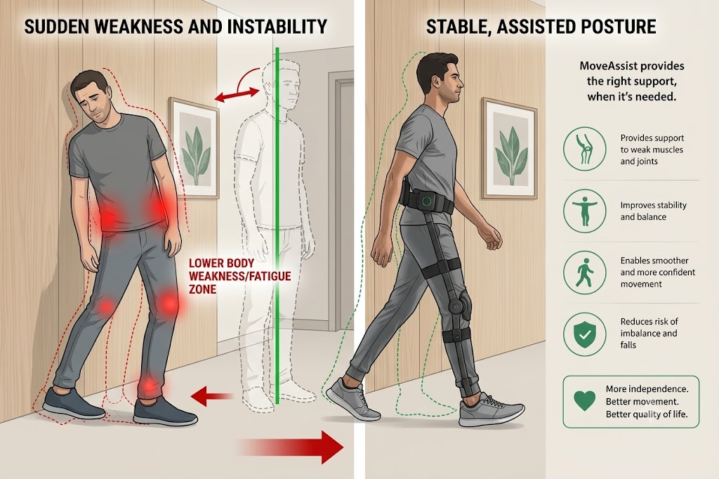
IDEA TITLE
Berserk
Techies
Explanation of the Problem :
After a stroke or other neurological conditions, weakness or poor control in parts of the body can make everyday movements difficult.
Reduced strength, coordination, or balance can make it difficult to perform movements steadily and safely.
Different people need different levels of support, and their needs can change as they improve during rehabilitation.
Proposed Solution :
Innovation and Uniqueness :
Movement Tracking: Sensors track leg movement, knee angle, and gait in real time.
Adaptive Assistance: The system estimates required effort and user contribution, then provides the needed support within safety limits.
User-Driven Recovery: The user performs the movement, while assistance automatically adjusts according to their performance.
Existing systems: Often use fixed assistance and can be heavy or expensive.
MoveAssist: Provides adaptive, assist-as-needed support based on the user’s movement and contribution.
Key Focus: Lightweight, adjustable, user-driven rehabilitation.

Slide 3
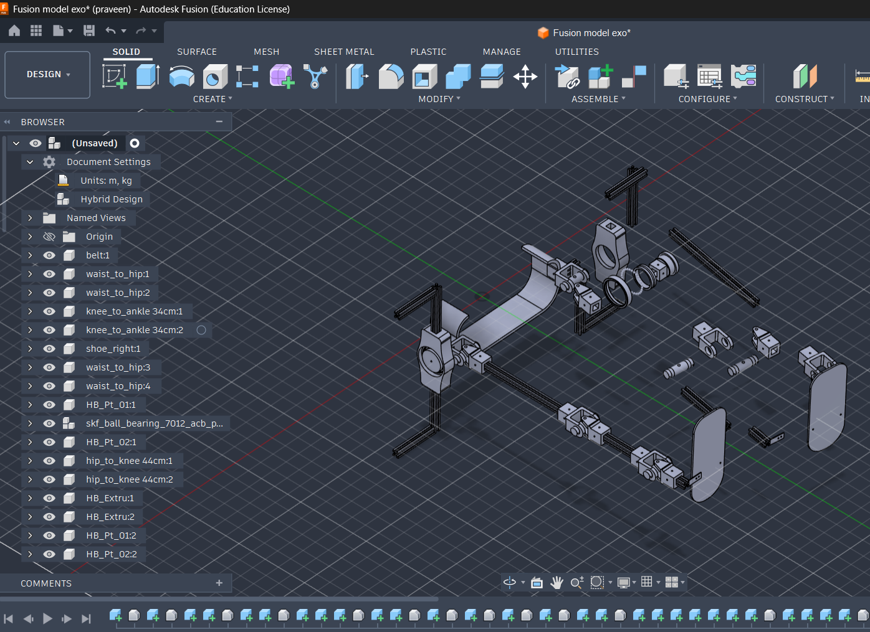
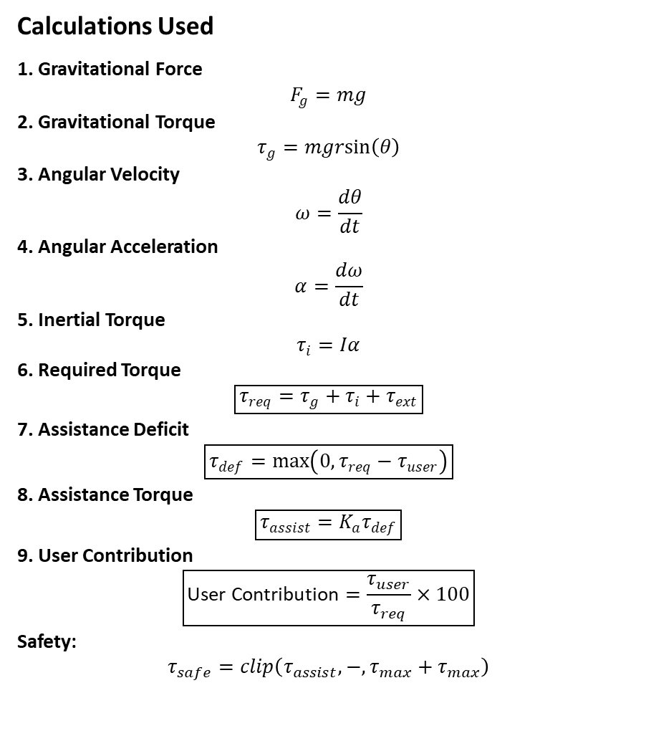
TECHNICAL APPROACH
Berserk
Techies
Fusion Model :
Calculations Used
1. Gravitational Force
$$F_{g}=mg$$
2. Gravitational Torque
$$τ_{g}=mgrsin⁡\left(θ\right)$$
3. Angular Velocity
$$ω=\frac{dθ}{dt}$$
4. Angular Acceleration
$$α=\frac{dω}{dt}$$
5. Inertial Torque
$$τ_{i}=Iα$$
6. Required Torque
$$\boxed{τ_{req}=τ_{g}+τ_{i}+τ_{ext}}$$
7. Assistance Deficit
$$\boxed{τ_{def}=max⁡\left(0 , τ_{req}−τ_{user}\right)}$$
8. Assistance Torque
$$\boxed{τ_{assist}=K_{a}τ_{def}}$$
9. User Contribution
$$\boxed{\text{User Contribution}=\frac{τ_{user}}{τ_{req}}×100}$$
Safety:
$$τ_{safe}=clip\left(τ_{assist} , − , τ_{max}+τ_{max}\right)$$

Slide 4
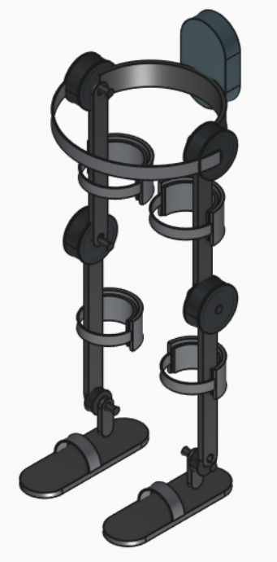
FEASIBILITY AND VIABILITY
Berserk
Techies
Final Prototype :
Feasibility
Technology: Uses existing sensors, motors, and microcontrollers.
Design: Modular and adjustable exoskeleton structure is achievable.
Control: AAN can adapt assistance based on user movement.
Prototype: Can be developed and tested step-by-step using available components.
Viability
Cost-Effective: Uses commercially available components and a modular design.
Practical: Suitable for controlled rehabilitation with therapist supervision.
Scalable: Can be upgraded with more sensors, joints, and improved software.
Accessible: Designed with future cost optimization and wider adoption in mind.

Slide 5
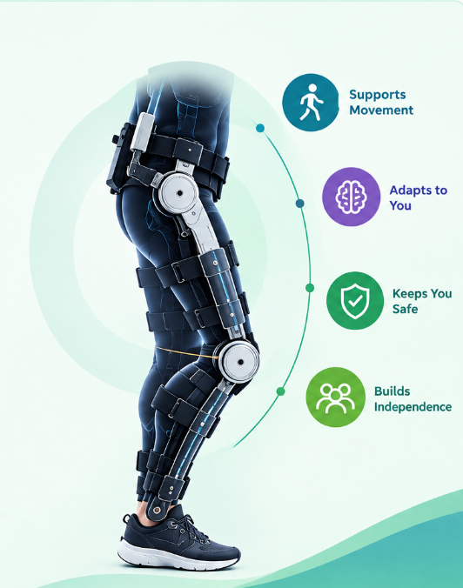
IMPACT AND BENEFITS
Berserk
Techies
IMPACTS
Patient-Centered: Supports the user's own movement.
Personalized: Assistance adapts to each user.
Progressive: Support can reduce as performance improves.
Safety-Focused: Monitors movement and limits unsafe actions.
Accessible: Modular approach for future cost optimization.
Research Impact: Enables development of adaptive rehabilitation technology.
BENEFITS
• Improved Mobility — Supports better movement and gait.
• Greater Independence — Encourages active patient participation.
• Enhanced Safety — Provides monitoring and protective control.
• Better Quality of Life — Supports functional recovery.
• Accessible Rehabilitation — Designed for wider future adoption.

Slide 6
RESEARCH AND REFERENCES
Berserk
Techies
RESEARCH :
HAL (Cyberdyne): Uses bio-electric/EMG signals and powered joints to detect the user's movement intention and provide assistance. Approximate reported cost: ₹47–95 lakh+.
ReWalk: Uses tilt and motion sensors with powered hip and knee joints. The user's body movement and center-of-gravity shift can initiate walking. Approximate reported cost: ₹67–95 lakh+.
EksoNR: Uses movement sensing, powered joints and adaptive assistance to adjust support during rehabilitation. Approximate reported cost: ₹57–76 lakh+.
Indego: Uses IMU/motion sensing with powered hip and knee joints in a modular wearable design. Approximate reported cost: ₹76–95 lakh+.
Atalante X (Wandercraft): Uses 12 motors, self-balancing control and multi-joint robotic assistance for hands-free overground rehabilitation. Price is not publicly listed.
REFERENCES:
Liancheng et al., 2026 — AAN + sensing
Foroutannia & Mohammadian, 2025 — mechanics + dynamics + control
Baud et al., 2021 — control architecture
Sensor Technologies & Control Strategies review, 2024 — sensors + rehabilitation

